Slide 1
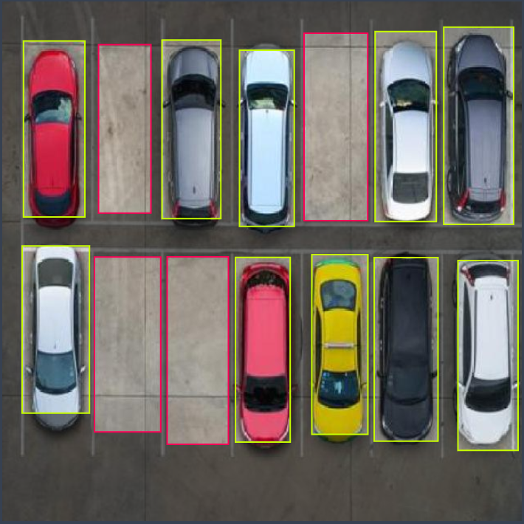
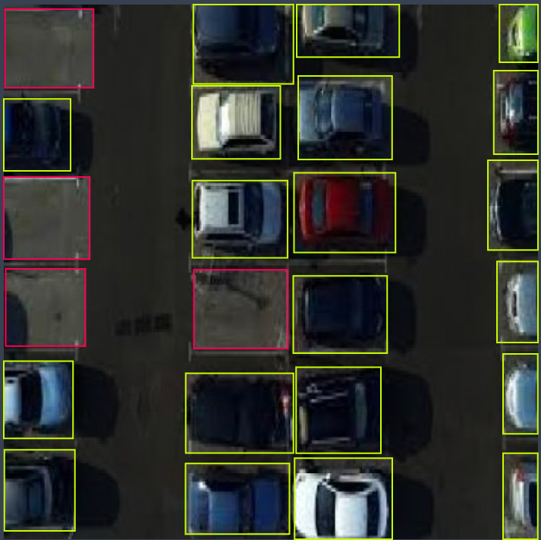
Computer vision yolov8
Aaron Morris Jara

Slide 2
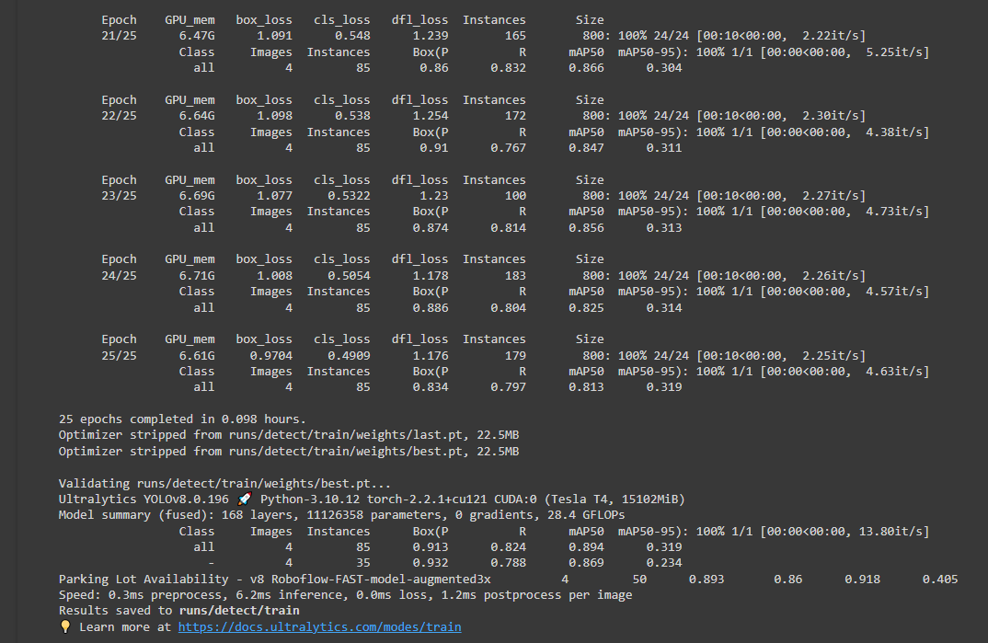
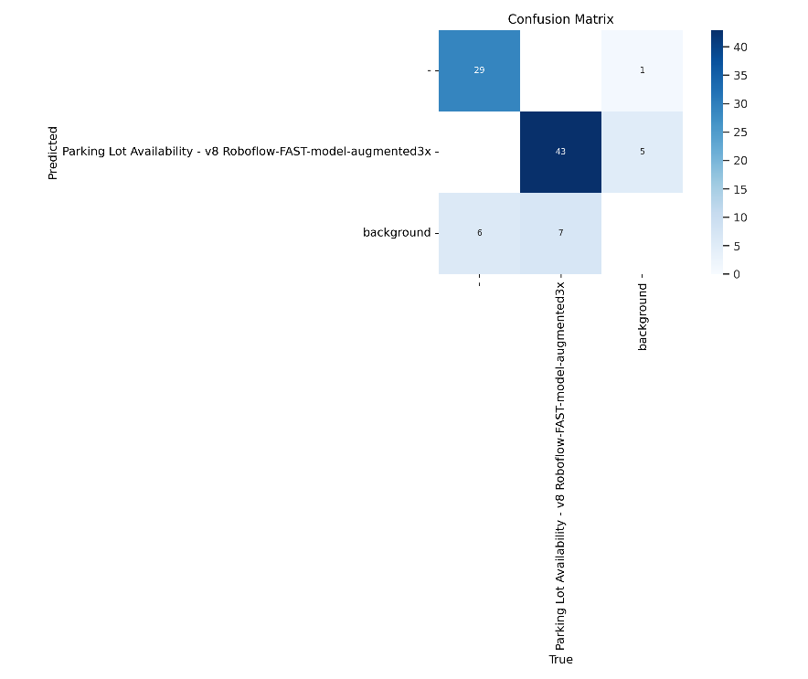
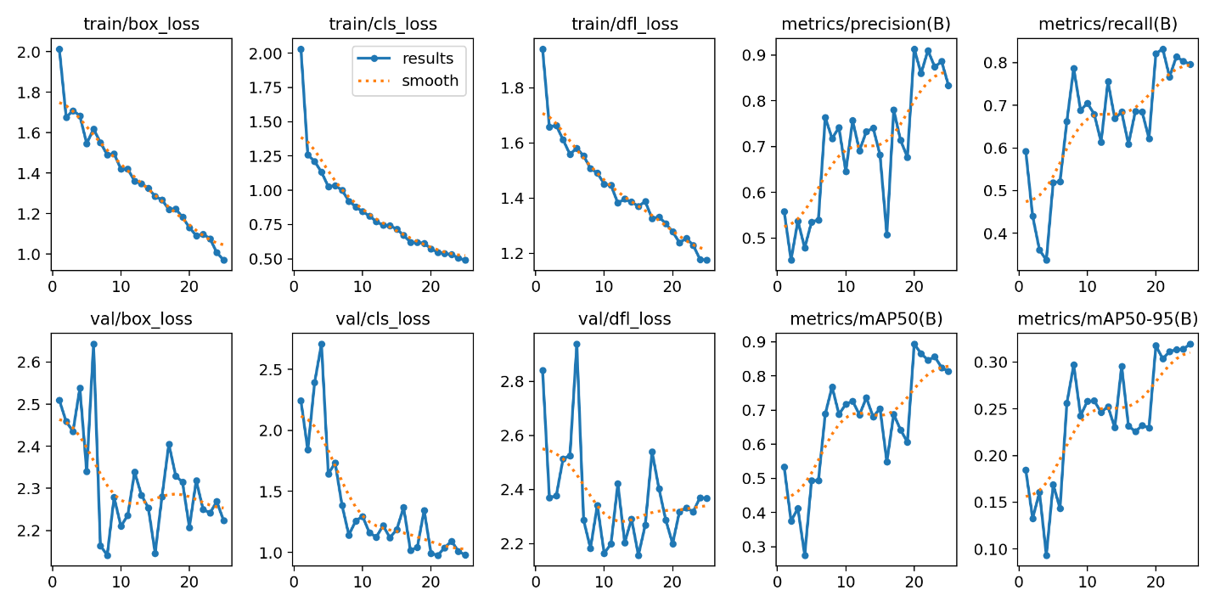
Training/Confusion matrix/results graphs
Training of dataset (25 epochs)
Confusion matrix
Results graphs

Slide 3
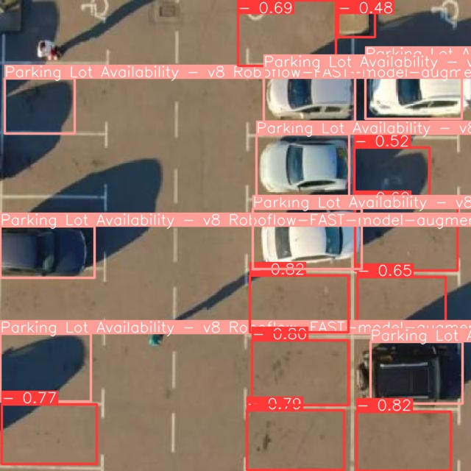
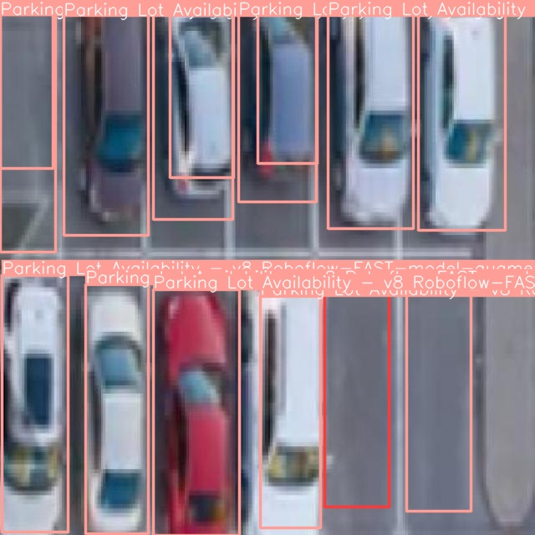
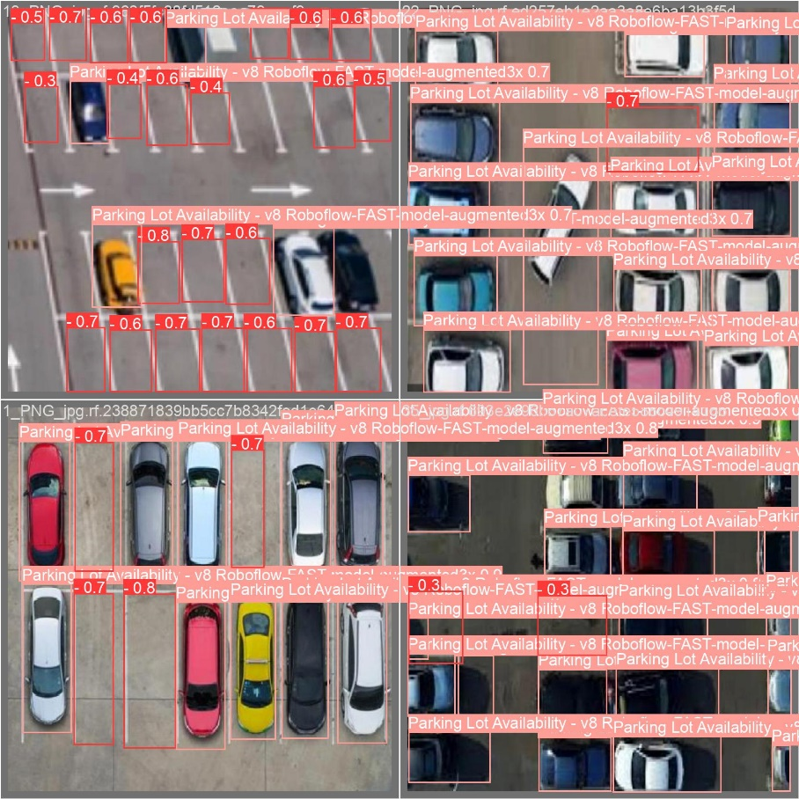
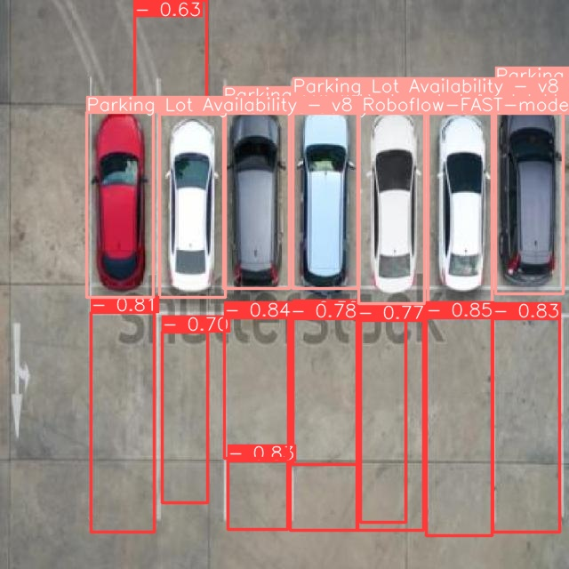
Validation/test non-annotated images
Testing non-annotated images
Validation

Slide 4
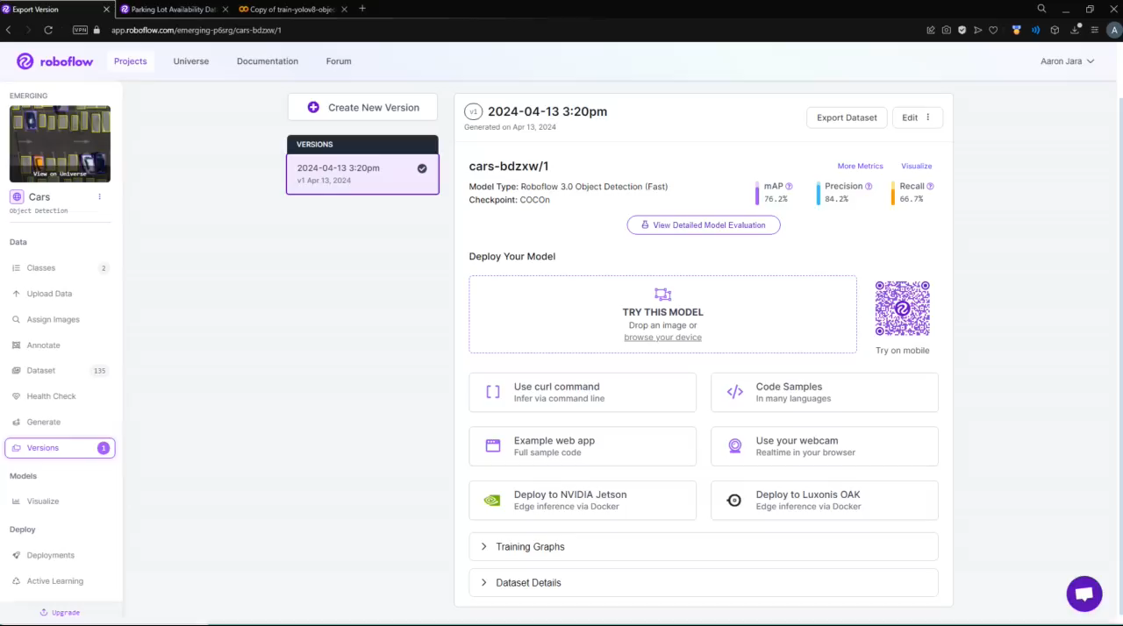
Demonstration (Video)

Slide 5
Reference
https://universe.roboflow.com/swee-xiao-qi/parking-lot-availability
@misc{
parking-lot-availability_dataset,
title = { Parking Lot Availability Dataset },
type = { Open Source Dataset },
author = { Swee Xiao Qi },
howpublished = { \url{ https://universe.roboflow.com/swee-xiao-qi/parking-lot-availability } },
url = { https://universe.roboflow.com/swee-xiao-qi/parking-lot-availability },
journal = { Roboflow Universe },
publisher = { Roboflow },
year = { 2022 },
month = { jul },
note = { visited on 2024-04-13 },
}

